Slide 1
YOLO Image Recognition and Object Detection
Adesh Ghadge
Ashish Mahadik
Shreejit Pant
Michael Zia

Slide 2
Agenda
Background / Model Architecture
Dataset Overview
YOLO Setup
Model Training / Testing on RCC / GCP
Model Evaluation
Future Work

Slide 3
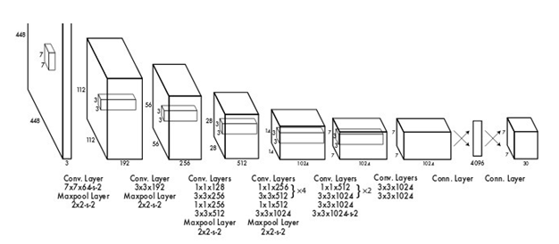
Background and Yolo architecture
Recognizing numbers and digits within natural scene imagery
Neural Networks allow for users to feed unstructured data, such as images, into algorithms which are then able to recognize objects and entities within them.
Recognizing multiple objects and identifying their position within an image require increasingly complex neural networks.
Compared to traditional convolutional networks, YOLO utilizes the entire image and applies a single neural network instead of sliding windows/filters. The image is regionally divided while simultaneously predicting bounding boxes for each region.

Slide 4
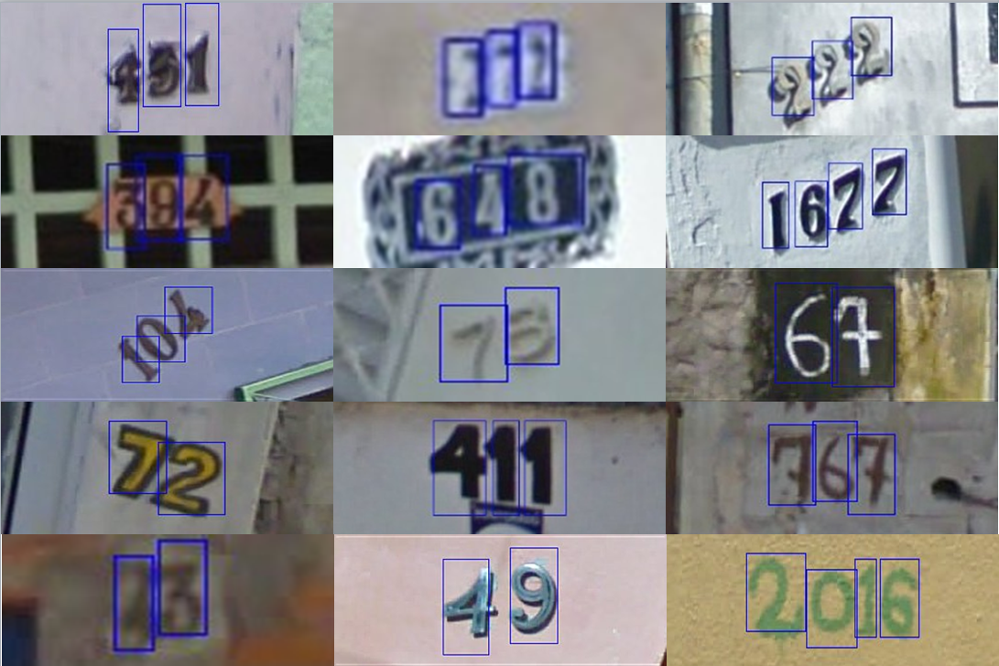
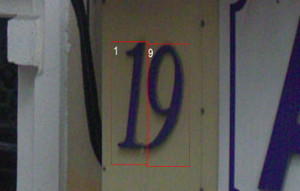
Dataset
Street View House Numbers provided by Stanford
House numbers obtained from Google Map’s street view
Training data consists of images that contain several digits with boundary boxes
.mat file accompanied the images with their metadata: height, label, left, top, and width.
Objective is to detect the digits within the images and identify each separately within bounding boxes

Slide 5
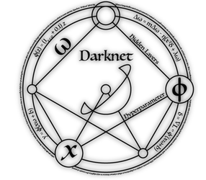
Setup
Utilization of YOLO first requires installation of Darknet.
Neural network framework written in C and CUDA which is open source.
Fairly straightforward installation on Mac and Linux (Windows users beware).
Training data must contain text file for each image notes their X and Y coordinates, as well as width and height
Transfer learning by utilizing pre-trained weights from ImageNet and YOLO for model training.

Slide 6
Trained on RCC
Darknet is already installed on RCC
Need to be part of mscagpu user group in order to use GPU
Not always available on demand. Need to wait for your turn
Setup was done on Mac using Python on Jupyter Notebook
Image labels and other info is stored in matlab file provided by Stanford in HDF5 format
Use h5py package to read file and pickle to serialize data as dictionary
Write text file with image paths, image label, height, width, bounding box coordinates
Update default configuration file (yolov3.cfg) based on number of classes in your data
Training took about 30 hours (~70,000 train and ~30,000 validation images)

Slide 7
TESTING on GCP
Detection of few images can be done on laptop/PC
Darknet (https://github.com/pjreddie/darknet) does not support testing for batch of images
Used a fork of the Darknet repository (https://github.com/AlexeyAB/darknet) - not installed on RCC
Google Cloud Platform – Compute Engine VM with Nvidia K80 GPU and Ubuntu 18.10
Google Cloud SDK – manage VM, SSH, transfer files
Installation of CUDA and cuDNN libraries can be challenging
Testing set was ~200,000 images; took about 15 hours
Cost about $5
Can use templates

Slide 8
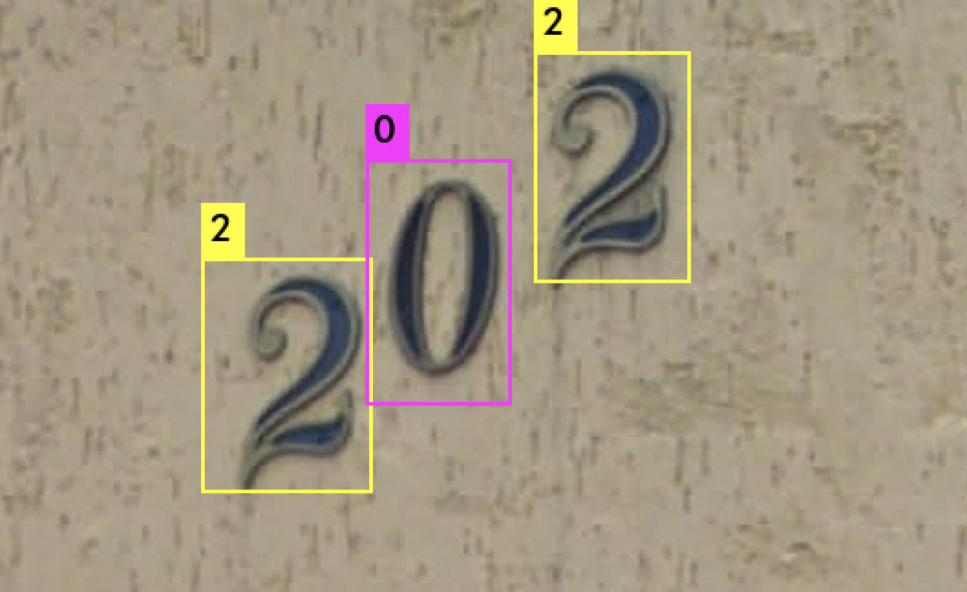
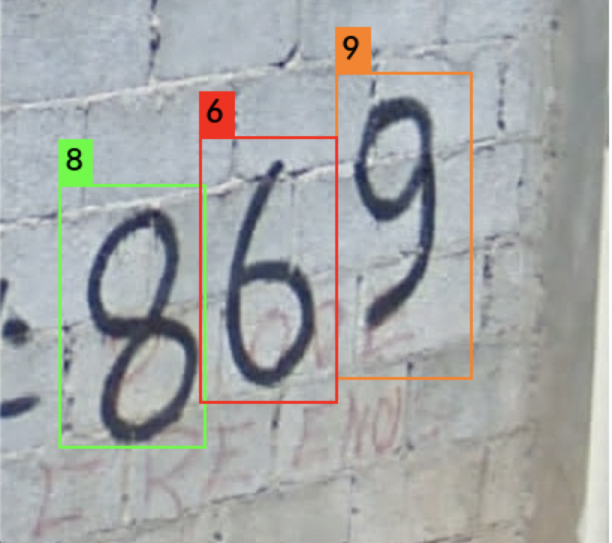
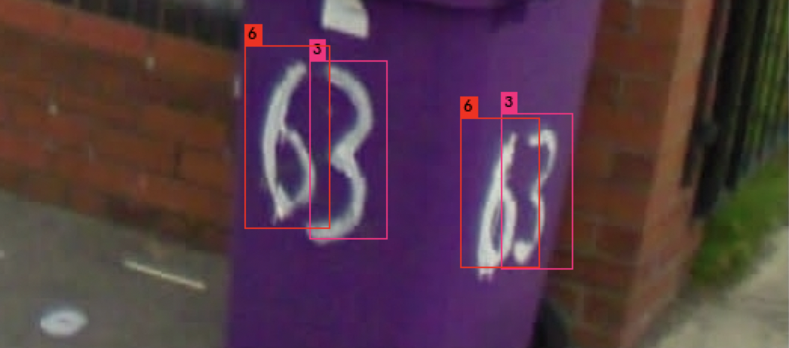
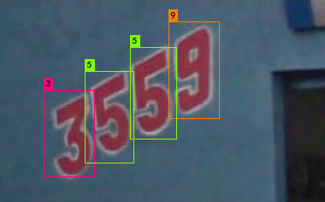
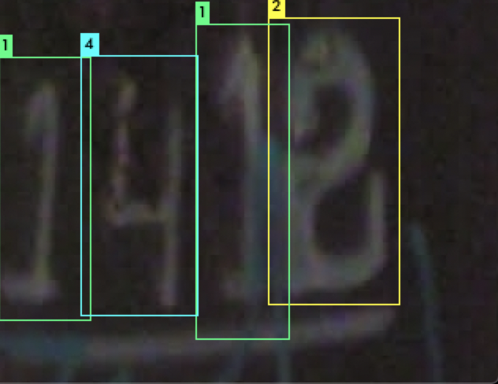
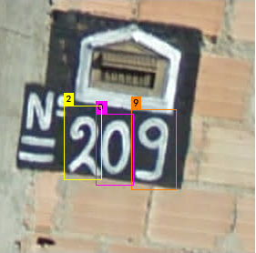
SAMPLES – Correct Predictions

Slide 9
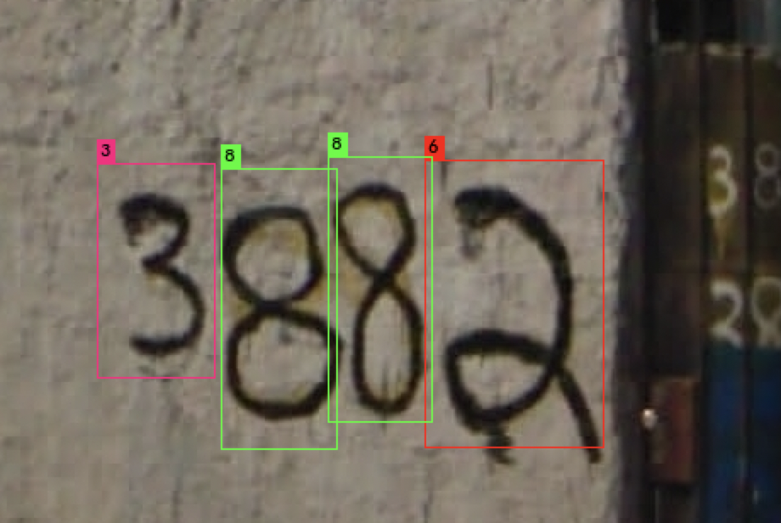
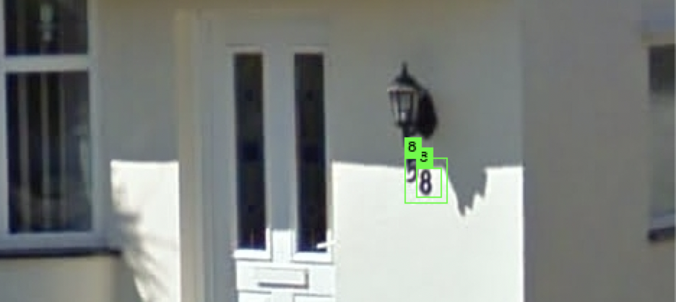
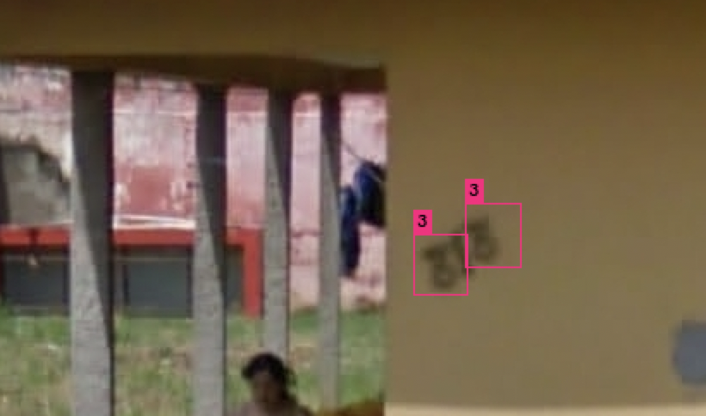
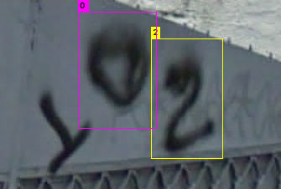
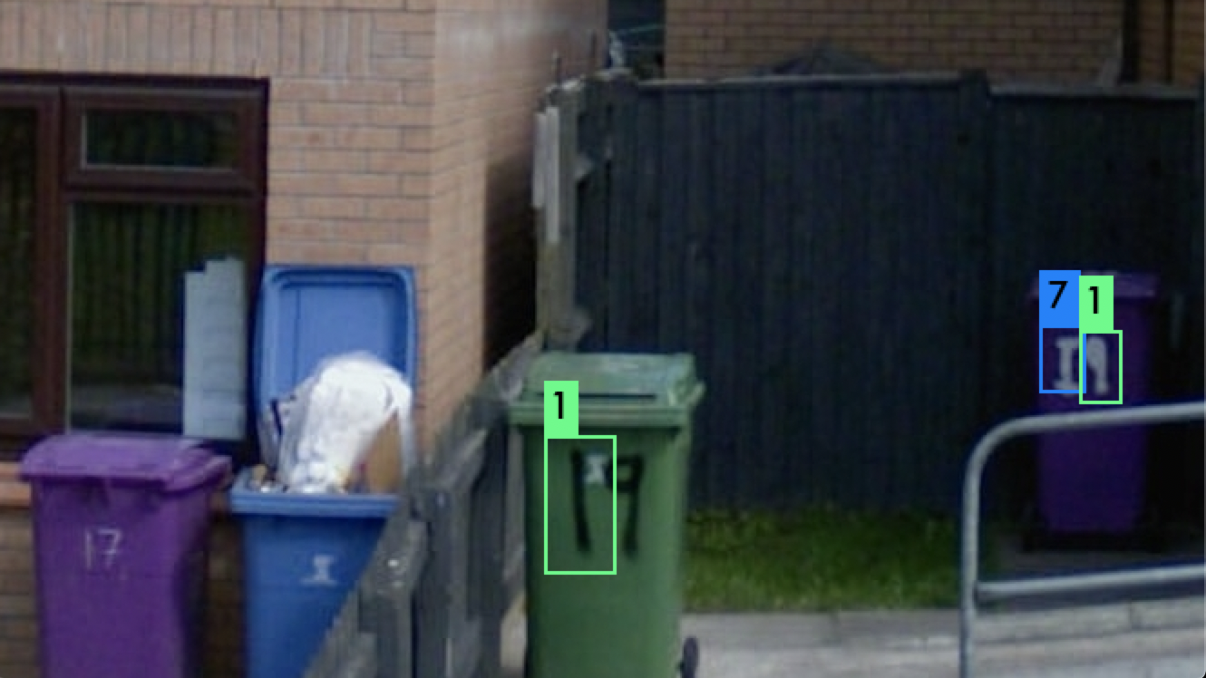
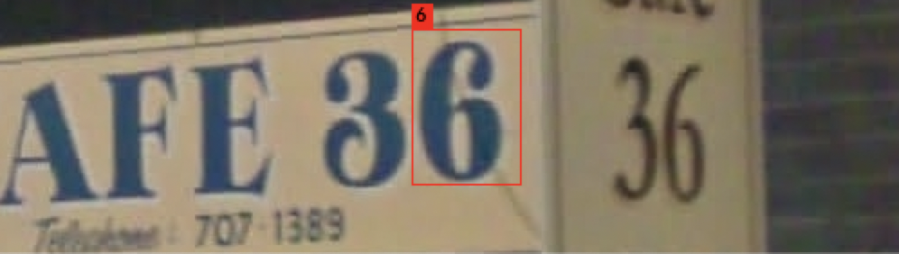
Samples – Incorrect Predictions

Slide 10
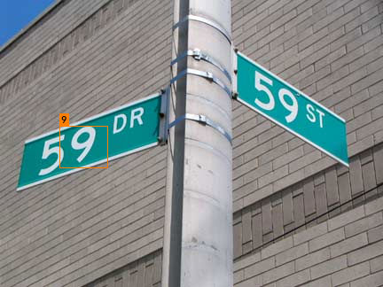
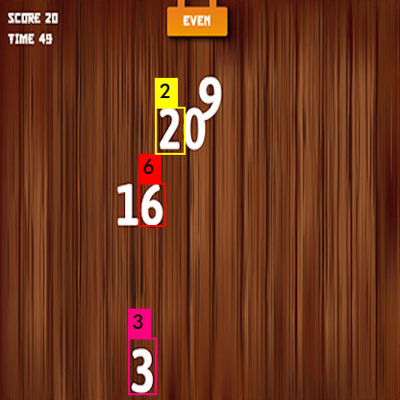
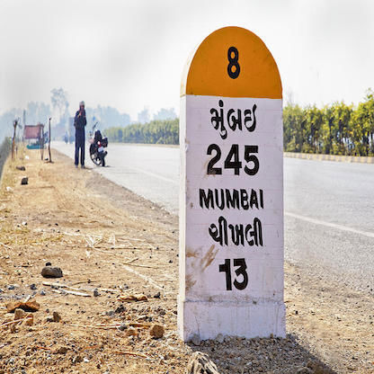
Out Of Sample Images

Slide 11
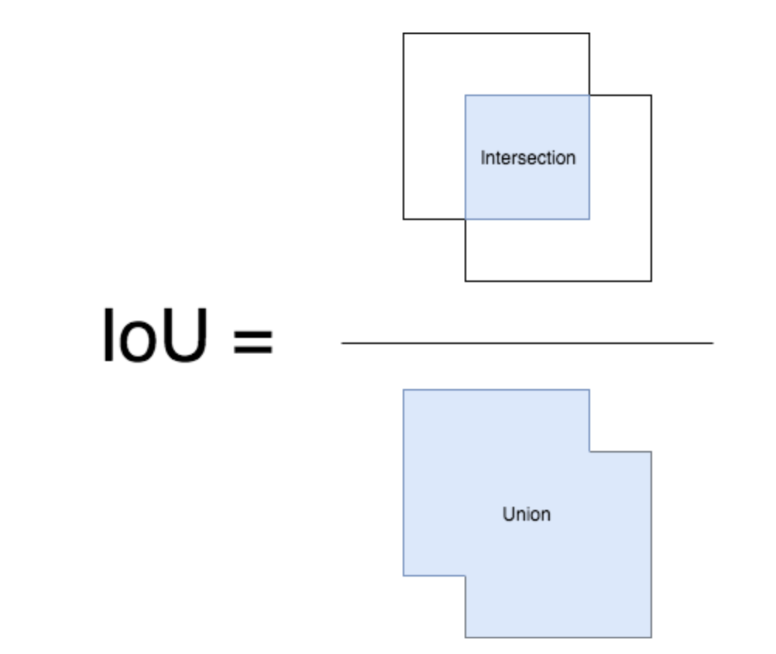
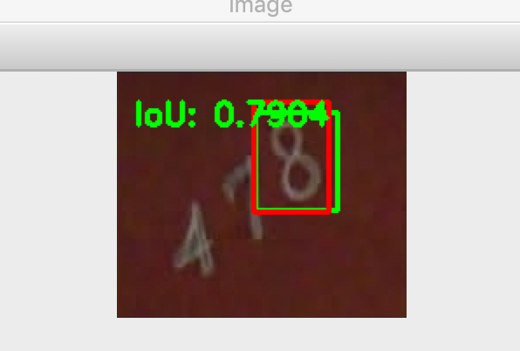
Model evaluation Of Yolo
Object detection models perform two task
Determining the location of the object (localization)
Determining what object exists in the image (classification)
Performance of Localization can be measured by Intersection over Union (IoU)
Iou is ratio of intersection & union of ground truth bounding box vs predicted bounding box
Performance of Classification can be measured by Mean average Precision (MaP)
Average precision across all classes in given problem with IoU threshold of 0.5
 | F1 Score | Precision | Recall | Support
By Digit | 0.939948 | 0.940067 | 0.940417 | 531,131
By Image | 0.623830 | 0.700810 | 0.599313 | 202,353

Slide 12
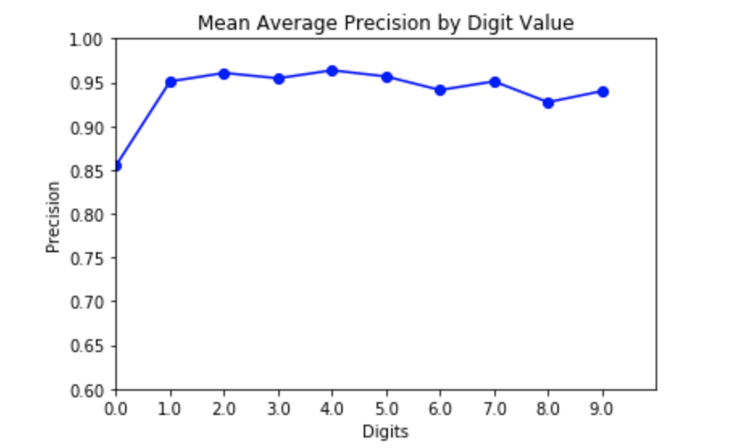
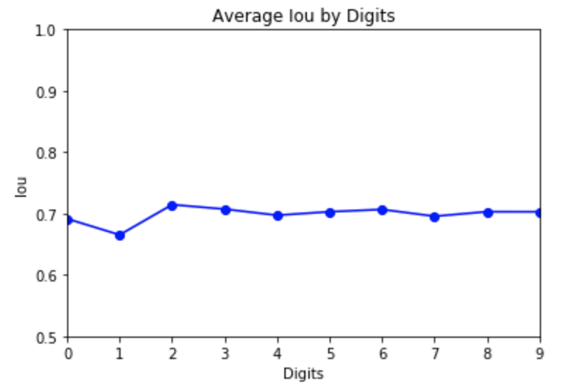
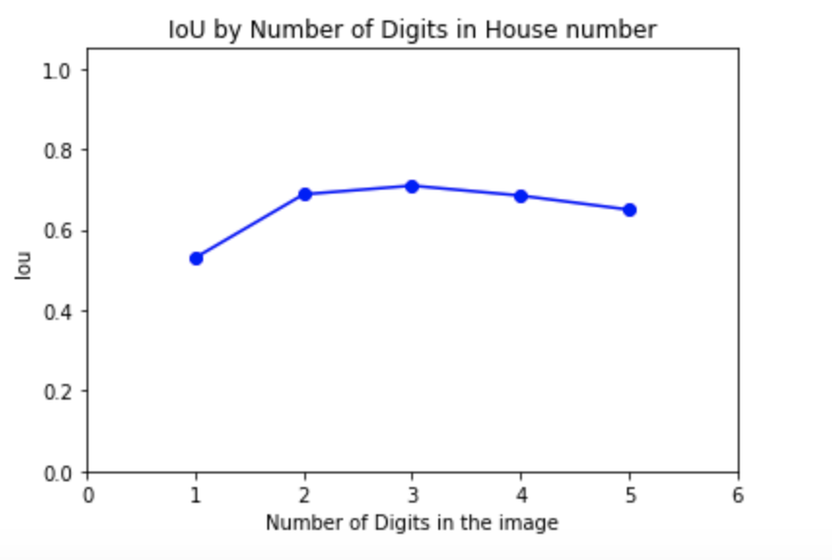
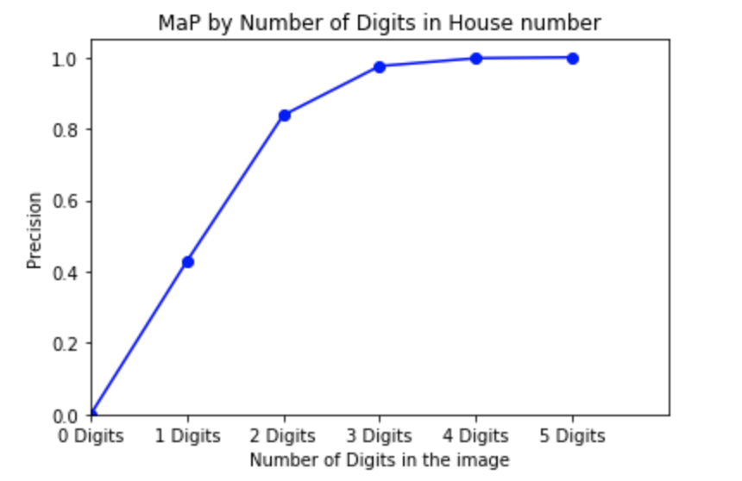
EVALUATION FOR SVHN DATASET (EXTRA DATASET)

Slide 13
Future Work
Current YOLO architecture allows for one image prediction at a time
In order to run predictions on multiple images, workarounds need to take place through third party GitHub repositories
https://github.com/AlexeyAB/darknet
Other test images containing digits that were downloaded from the internet were not identified
Possible issues are the image sizes, background noise, less training on images with more information present within them
Single digits images are less accurately detected, compare other multidigit images.

Slide 14
Appendix
http://ufldl.stanford.edu/housenumbers/
https://pjreddie.com/darknet/yolo/
https://github.com/penny4860/Yolo-digit-detector
https://github.com/devinsaini/svhn
https://github.com/AlexeyAB
https://github.com/prijip/Py-Gsvhn-DigitStruct-Reader/blob/master/digitStruct.py
https://medium.com/@jonathan_hui/real-time-object-detection-with-yolo-yolov2-28b1b93e2088
https://towardsdatascience.com/yolo-you-only-look-once-real-time-object-detection-explained-492dc9230006
https://www.kdnuggets.com/2018/09/object-detection-image-classification-yolo.html
https://cloud.google.com/sdk/docs/

